Slide 1
Visualizing Networks,
Timelines, and Texts
JOUR479D/779D
University of Maryland
Nick Diakopoulos

Slide 2
Networks

Slide 3
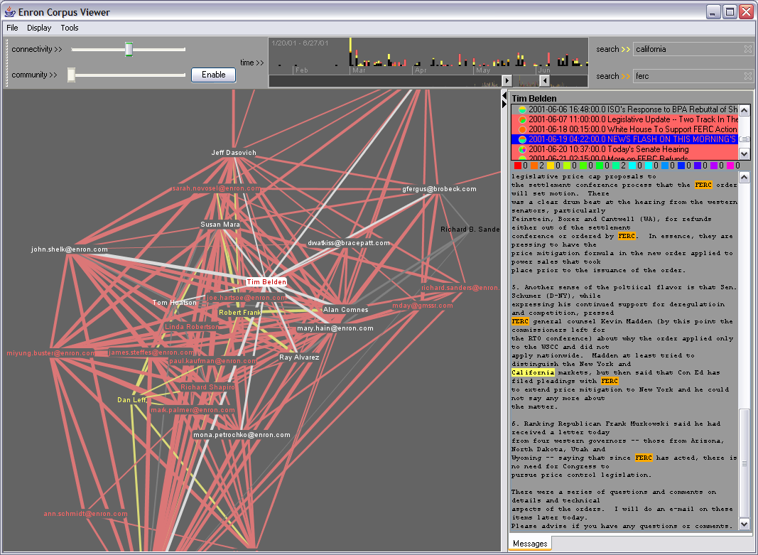
Notes:
Why networks? Can see relationships in communication … e.g. in this Enron corpus of emails you can see who was responding to whom

Slide 4
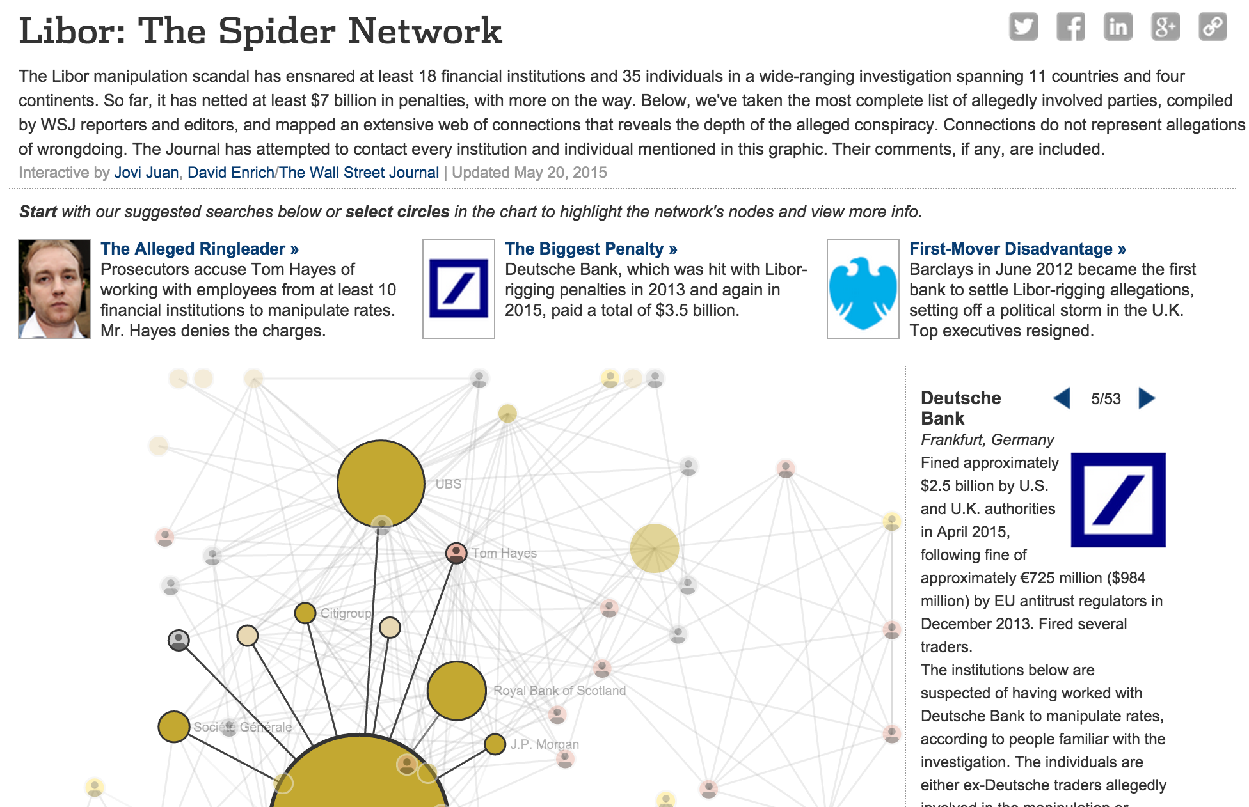
http://graphics.wsj.com/libor-network/#item=DB
Notes:
Why Networks? Useful in investigations for keeping track of relationships. Example shows relations in an investigation, highlights key individuals, click for more details or advance 1 by 1.

Slide 5
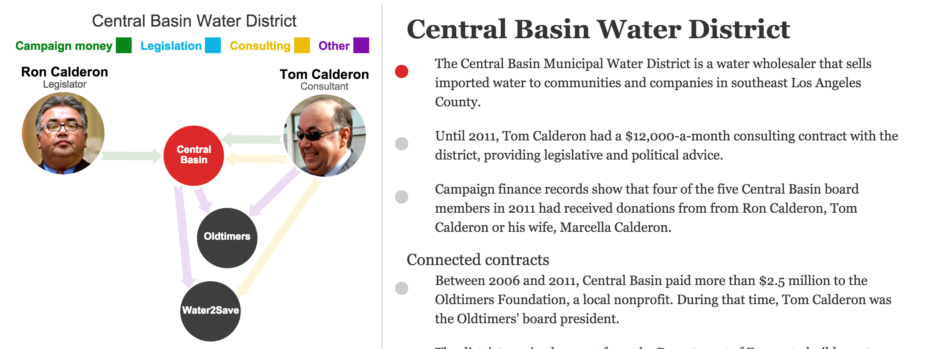
http://graphics.latimes.com/calderon/
Notes:
Static layouts more or less, but includes scrollytelling features that highlights different relationships as you scroll.
Also interesting in that it provides a lot more detail on the relationship when you hover a link.

Slide 6
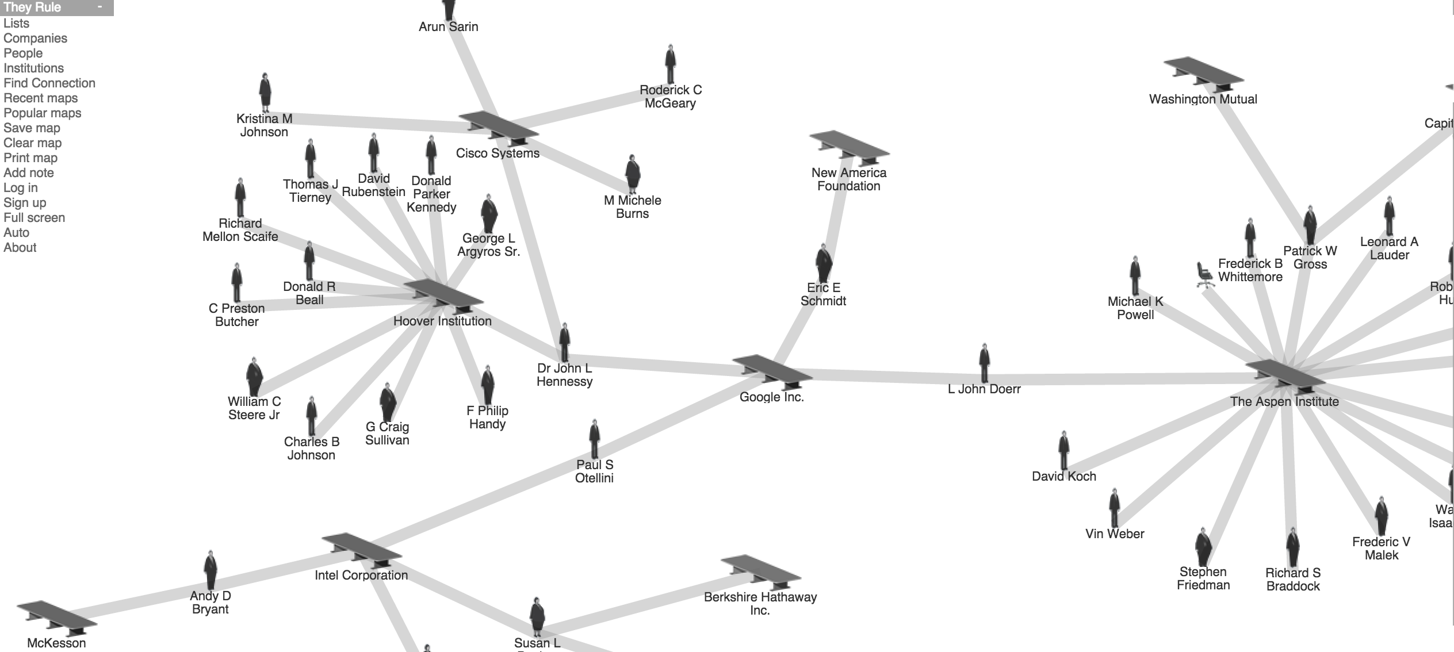
http://theyrule.net/drupal/
Notes:
For doing network investigations … there are network databases of relationships that can help understand who’s connected to whom. They rule lets you see connections between different companies based on the people serving on boards.

Slide 7
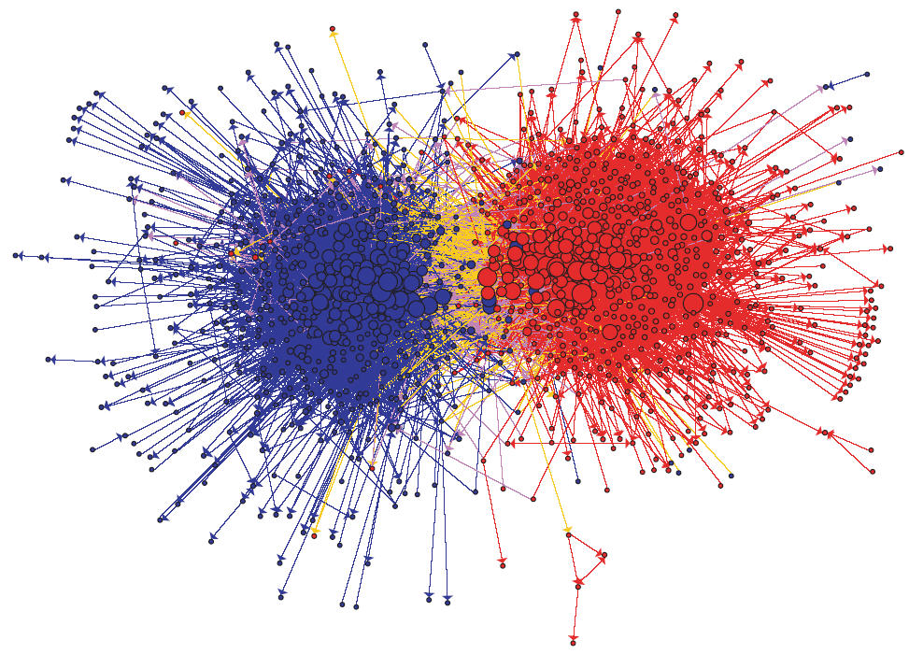
Notes:
Networks can also be useful for understanding social media linking patterns. E.g. Political blogging – who links to whom?
Political blogosphere shows the hairball issue … at least you can still see the major clusters, which is probably the important story here, but you still miss any nuance within those groupings.

Slide 8
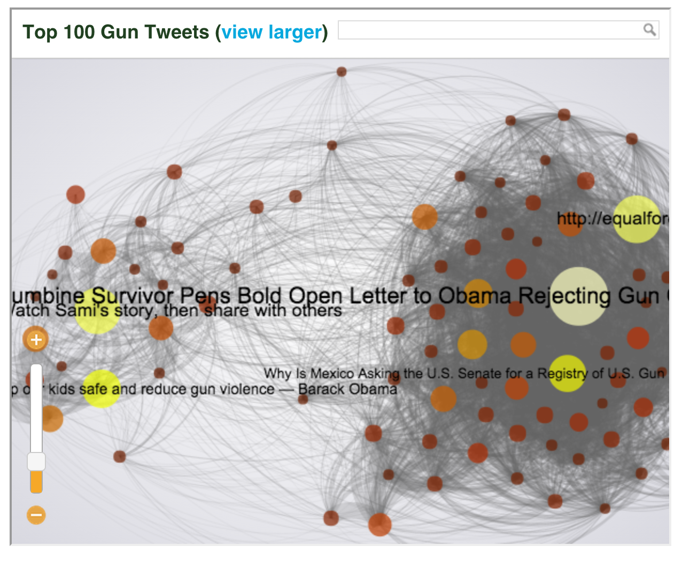
http://www.theatlantic.com/national/archive/2013/02/the-whole-dysfunctional-national-conversation-about-guns-on-twitter-in-one-interactive-graph/273499/
Notes:
Networks can also be useful for illustrating how people are talking about the news.
Nodes are top links shared on twitter about gun violence. An edge is drawn only if the two links were shared by the same person.

Slide 9
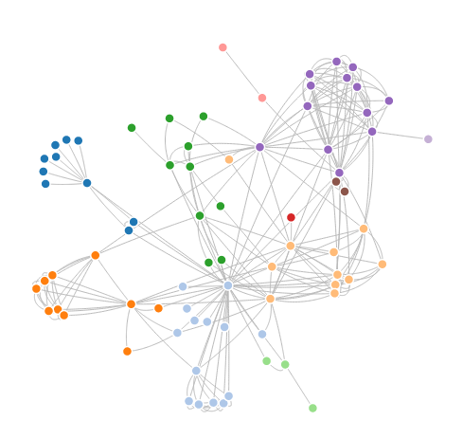
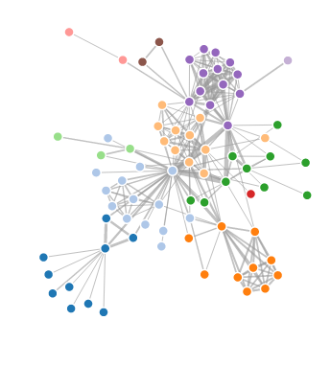
Trusty Node-Link
Notes:
Node link diagram is probably the most familiar when we talk about networks. Such diagrams consists of nodes and links or edges
Can encode things on nodes, and on edges. You can also have edge weights and map weight to edge width.

Slide 10
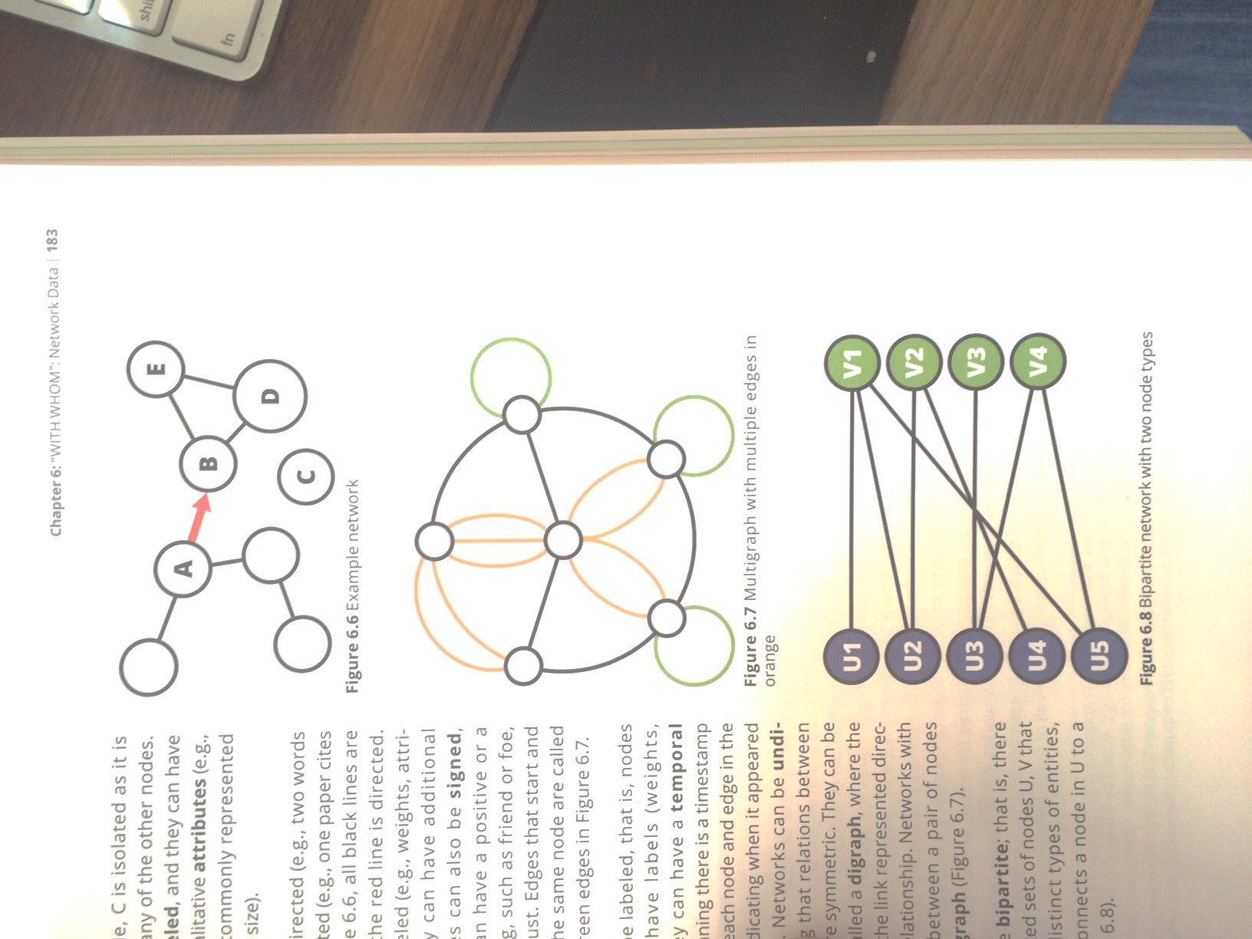
Directed / Self directed
A->B: Chat history, @ reply
B-D: telephone lines
Notes:
. The edges can be directed, or undirected. A directed relation is something that’s assymetric. So if we were to plot out a chat history, or a tweet history, a directed node would be if I said something TO someone else. Other kinds of relationships are undirected, like say the telephone lines that used to connect different buildings, or the internet lines that still connect things.

Slide 11
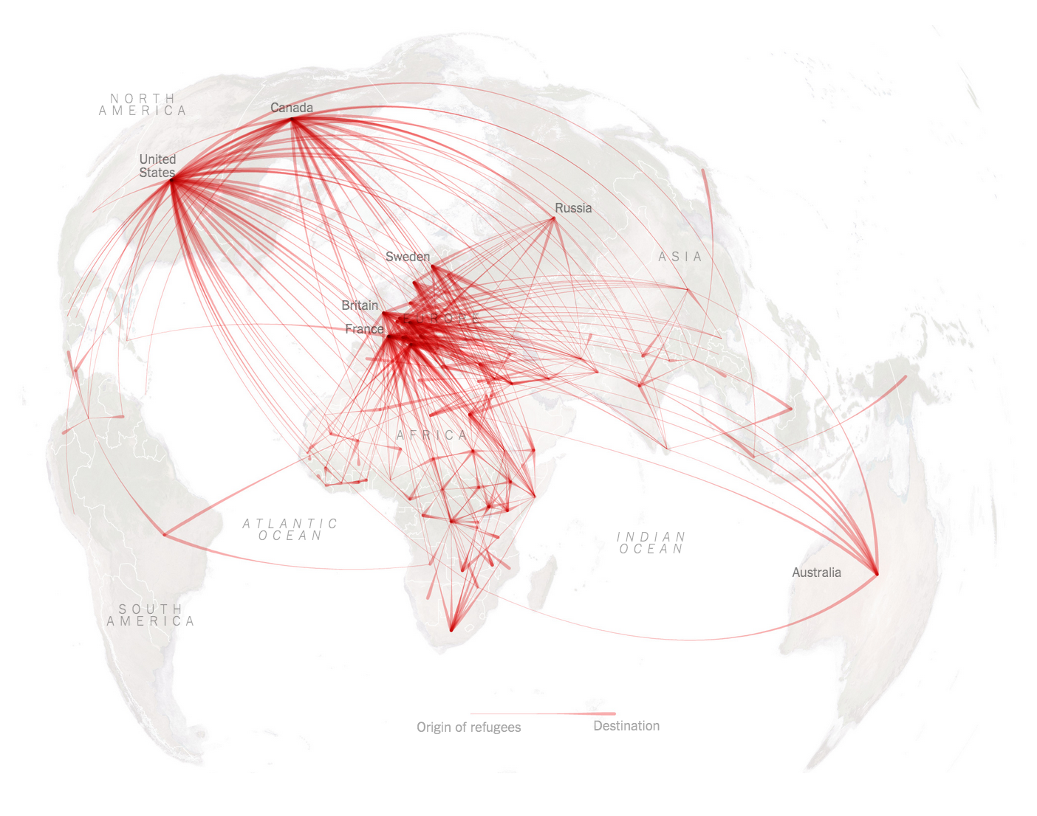
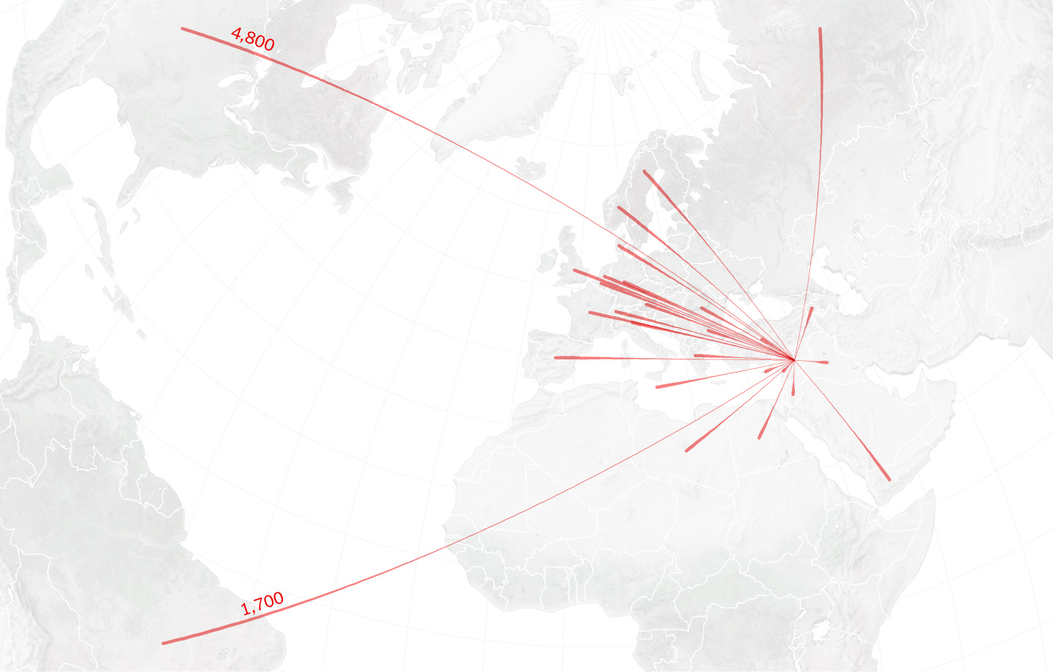
http://www.nytimes.com/interactive/2015/06/21/world/map-flow-desperate-migration-refugee-crisis.html
Notes:
You can also combine networks with maps. This is showing refugees flows around the world. Not every directed graph uses arrows. In this example the origin is thin and the destination is thick.

Slide 12
Nomenclature
Degree
Number of edges connected to a node
Shortest Path
Number of edges to traverse to get between 2 nodes
Betweenness Centrality
Number of shortest paths between pairs of nodes that pass through a given node
Disconnected Component
A cluster of nodes not connected to the main cluster of nodes

Slide 13
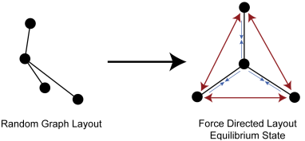
Force Directed Layouts
Nodes repel
Edges are like springs
Notes:
Algorithms minize edge crossings and node overlaps. But the layout is still not stable, it depends on the initial placement of the nodes (i.e. the randomness). As a result proximity can at times be misleading b/c nodes could be near each other due to a random starting condition, rather than any real relation. But the ambiguity can be misleading.
The instability of layouts is mitigated by running a layout once on a server and then storing the locations of the nodes, but of course then you can’t update the nodes.

Slide 14
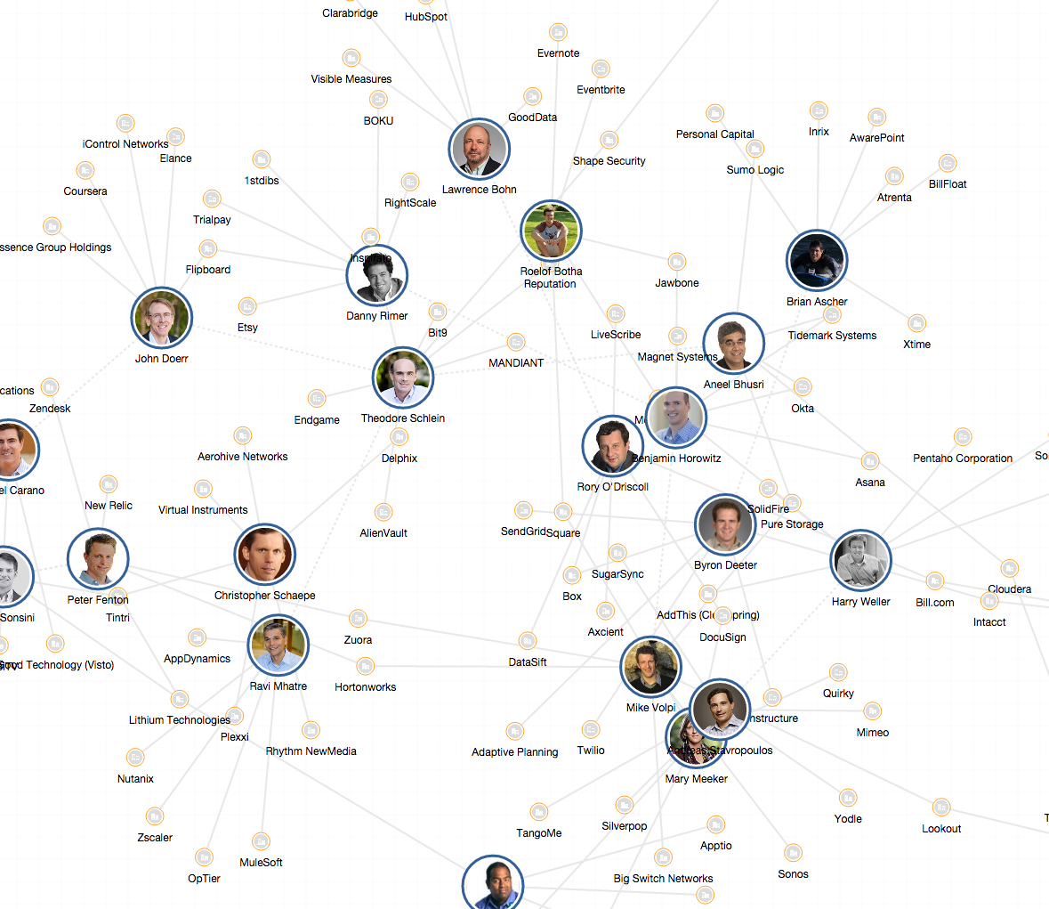
https://www.cbinsights.com/top-tech-ipo-pipeline-investors-social-graph/?view=graph
Notes:
https://www.cbinsights.com/top-tech-ipo-pipeline-investors-social-graph/?view=graph
Shows use of betweenness centrality. And force directed layout.

Slide 15
Node-Link Pro/Cons
Pro
Intuitive
Good for understanding topological structure (clusters)
Path tracing to see connections via other nodes
Con
Not scaleable (limit around a few hundred nodes)
Easily turn into hairballs
Layout is non-stable so it changes run to run, or if you add nodes or edges → Hard to compare
Notes:
Networks good for exploratory, investigative stuff to keep track, but also communicating and understanding dissemination networks of media.

Slide 16
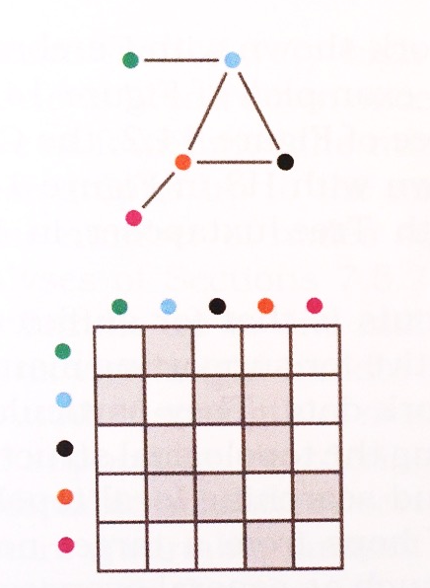
Adjacency Matrices
Notes:
Nodes are along horizontal and vertical, and edge is indicated by filling in the intersection of row and column.
Advantage is that they are highly scaleable, basically to the number of pixels you have, and even then you can aggregate with them much more easily. But on the other hand you lost the typological information. And they aren’t as intuitive. You can do fancy things like reorder the rows or columsn to help show structure though.
You can also use other encodings on the grid, like color, or luminance to encode categorical or ordinal variables associated with the nodes or links (e.g. edge weight).
If your network Is symmetric you only need half the matrix.

Slide 17
Timelines

Slide 18
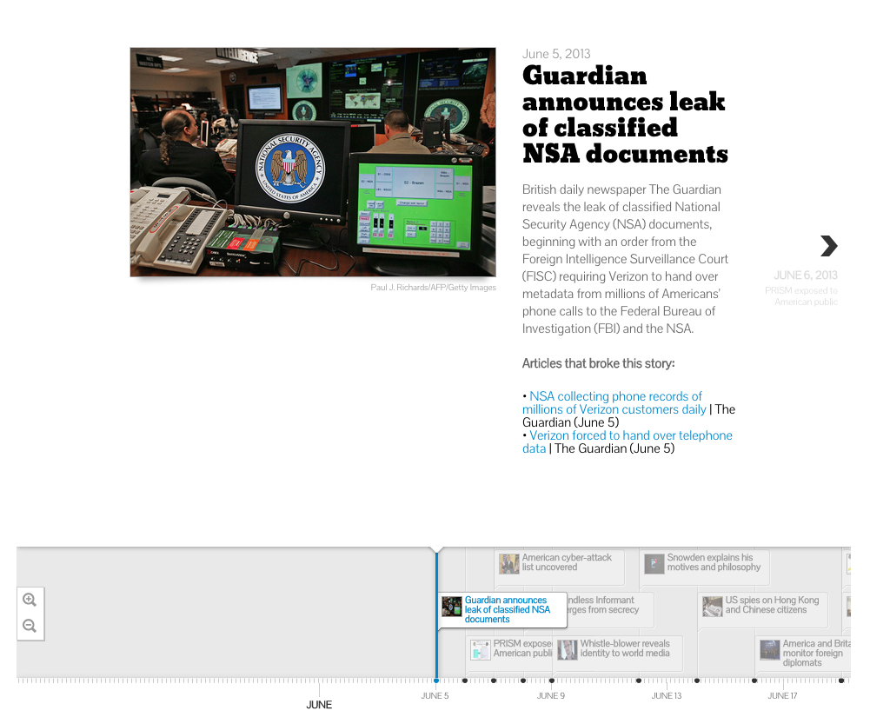
http://america.aljazeera.com/articles/multimedia/timeline-edward-snowden-revelations.html
Notes:
timelines can be useful for plotting events in an emerging story, and for retrospectives that put more historical events in context

Slide 19
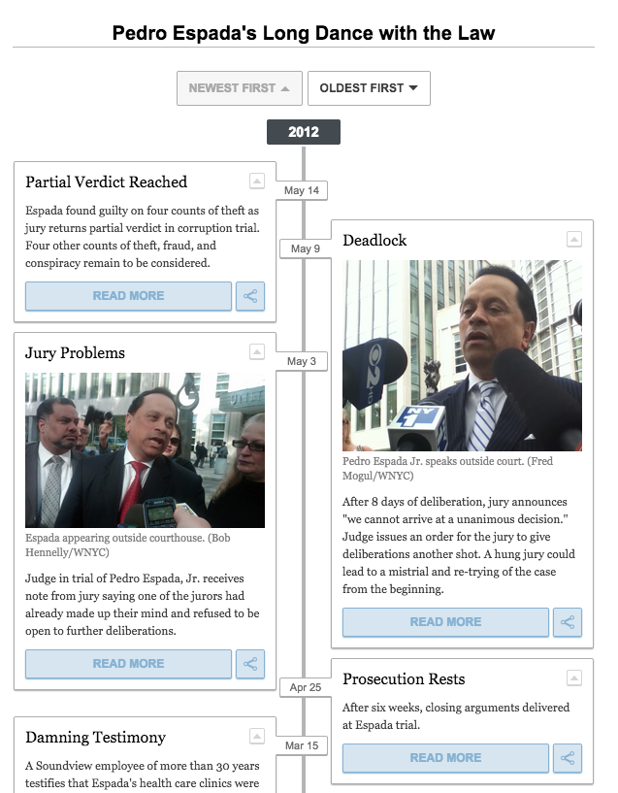
http://www.wnyc.org/story/207211-timeline-pedro-espadas-long-dance-law/
Notes:
Timelines don’t have to be horizontal either, they could be vertical.

Slide 20
Timeline Graphical Conventions
Uniform Timescale
Time indicators
Labeling dates and intervals with gridlines
Thematic annotations
Label periods of context, e.g. periods of recession, control of congress
Line length = length of time

Slide 21
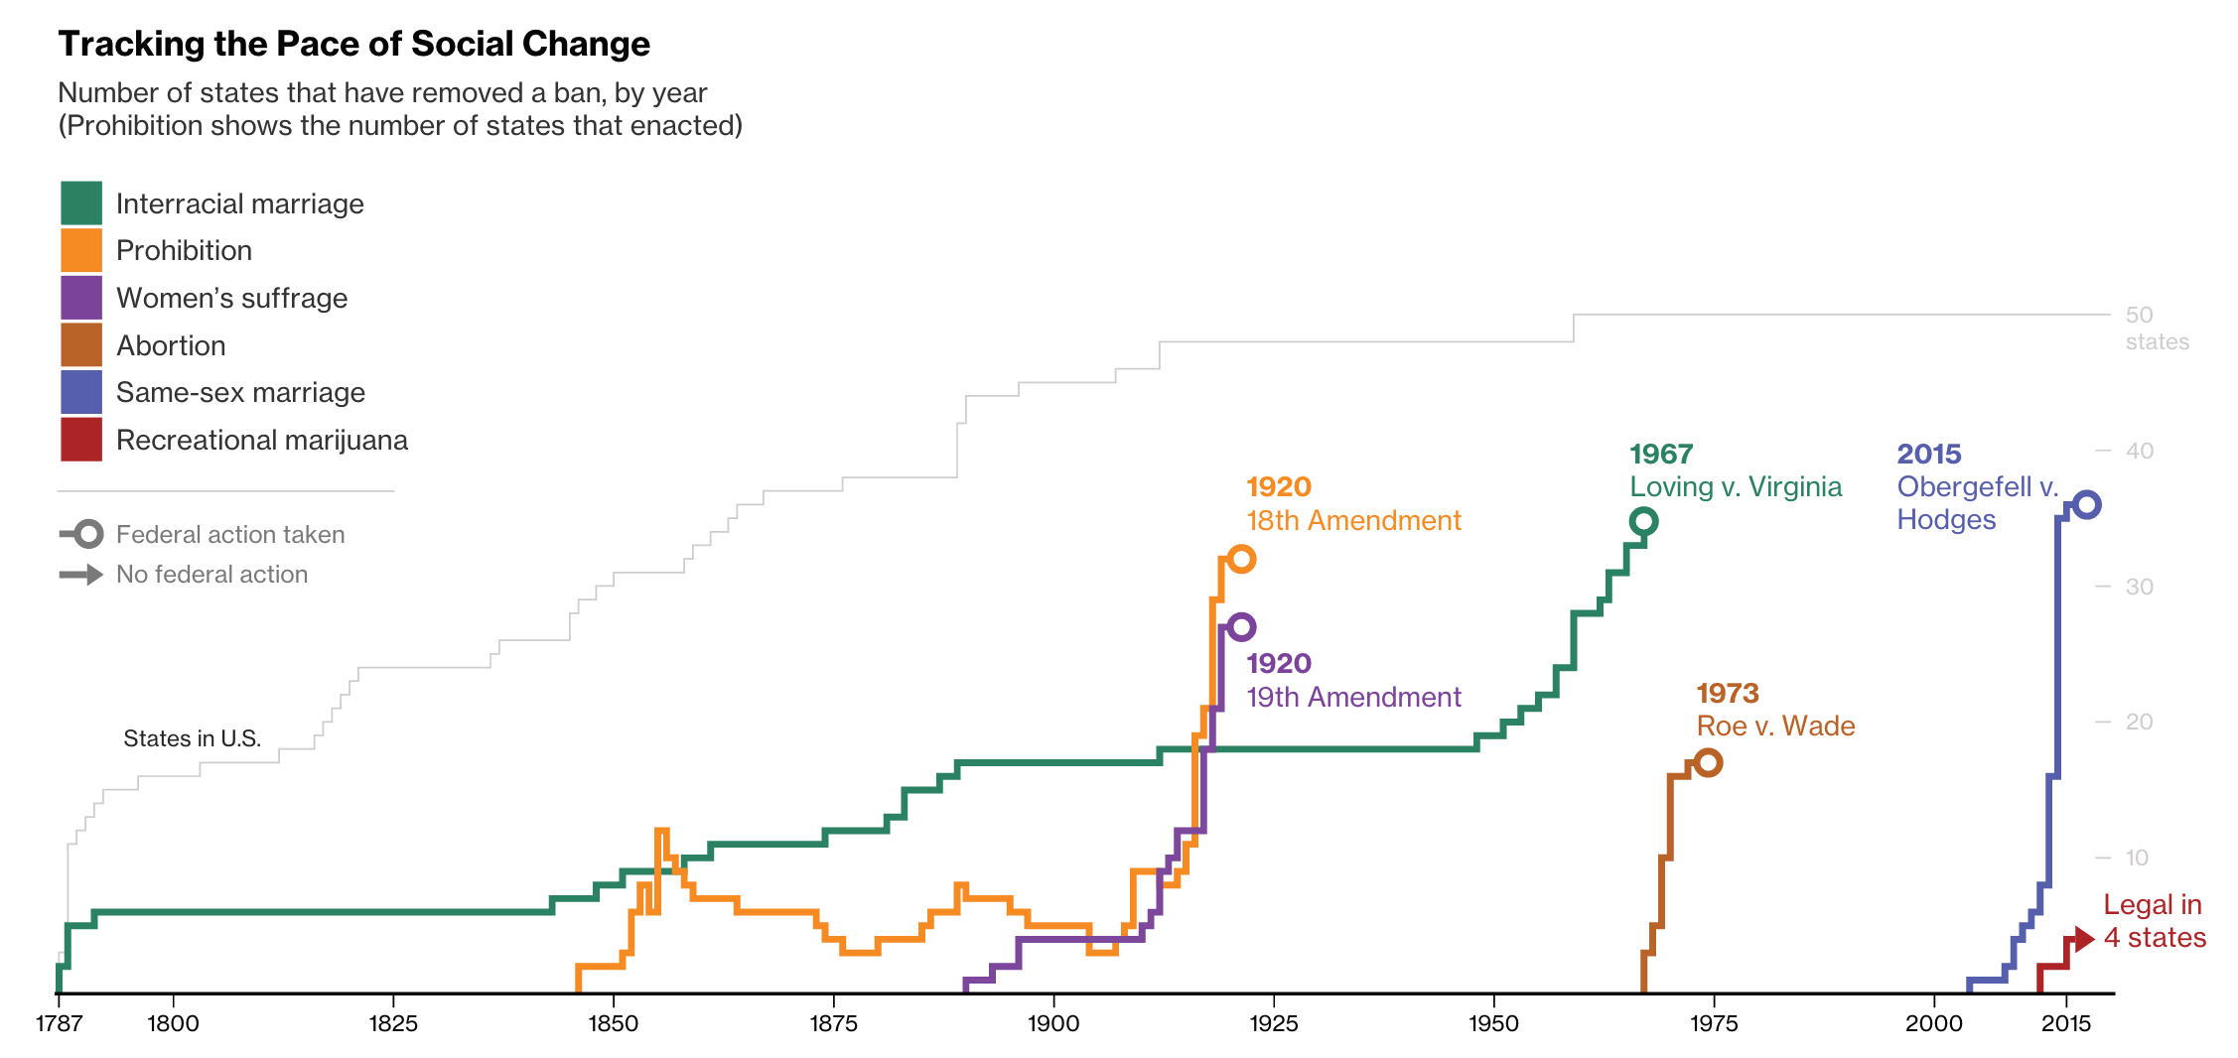
http://www.bloomberg.com/graphics/2015-pace-of-social-change/
Notes:
Timelines can also be useful for showing an overview of change. This is an example that makes great use of animation and also allows for great comparison for shapes of movements and how they unfolded over time.

Slide 22
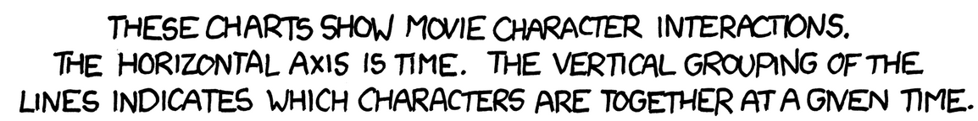
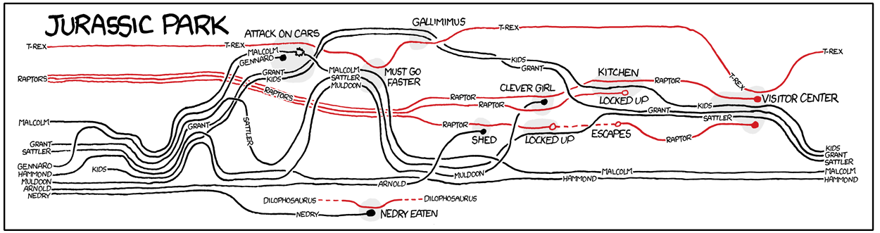
https://xkcd.com/657/large/
Notes:
Can also have more conceptual or thematic timelines that help you understand the structure of how an event unfolded.

Slide 23
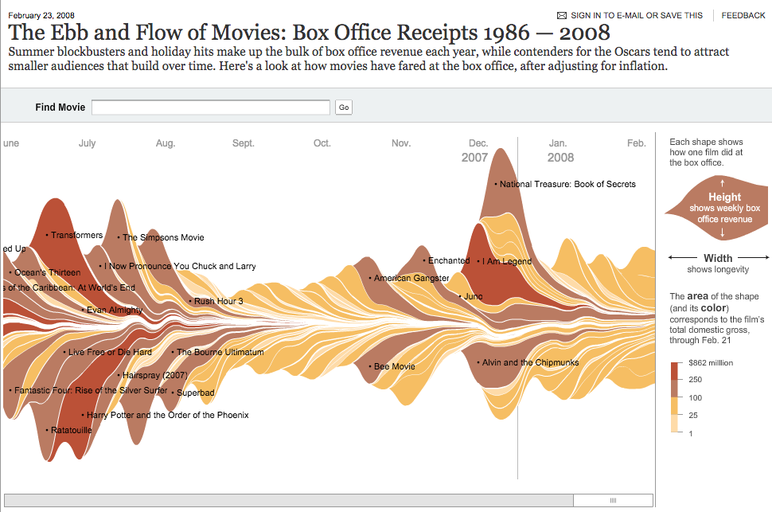
http://www.nytimes.com/interactive/2008/02/23/movies/20080223_REVENUE_GRAPHIC.html?_r=0
Notes:
Timelines are also useful for showing temporal trends. This one is called a streamgraph. Discuss issue of changing baseline. But it does down the overall trend of box office receipts.

Slide 24
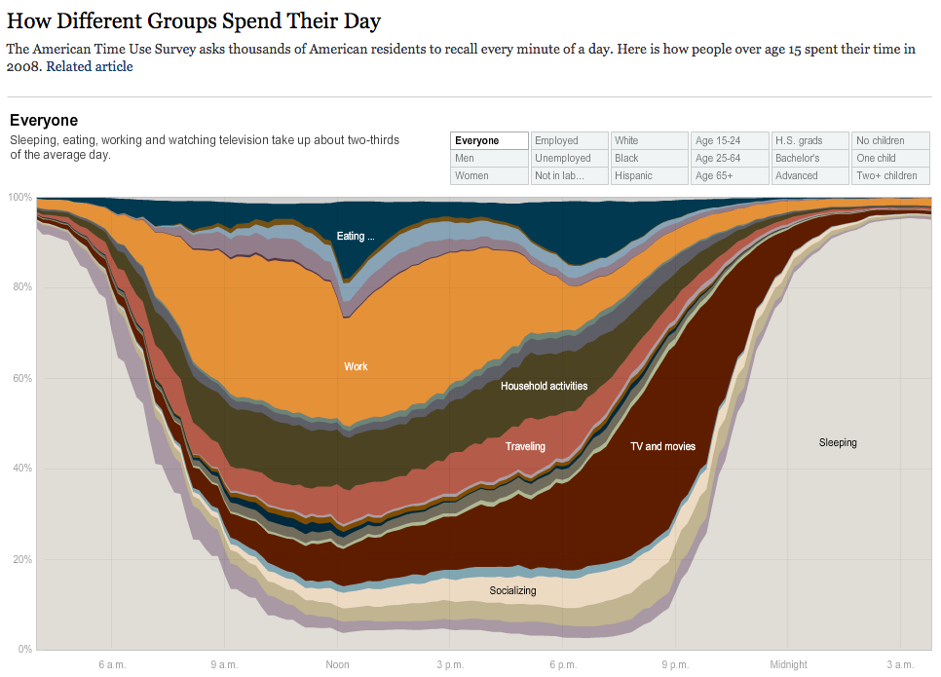
Notes:
The issue here is that there’s no continuity between 4am and 5am, so you might also try a circular layout.

Slide 25
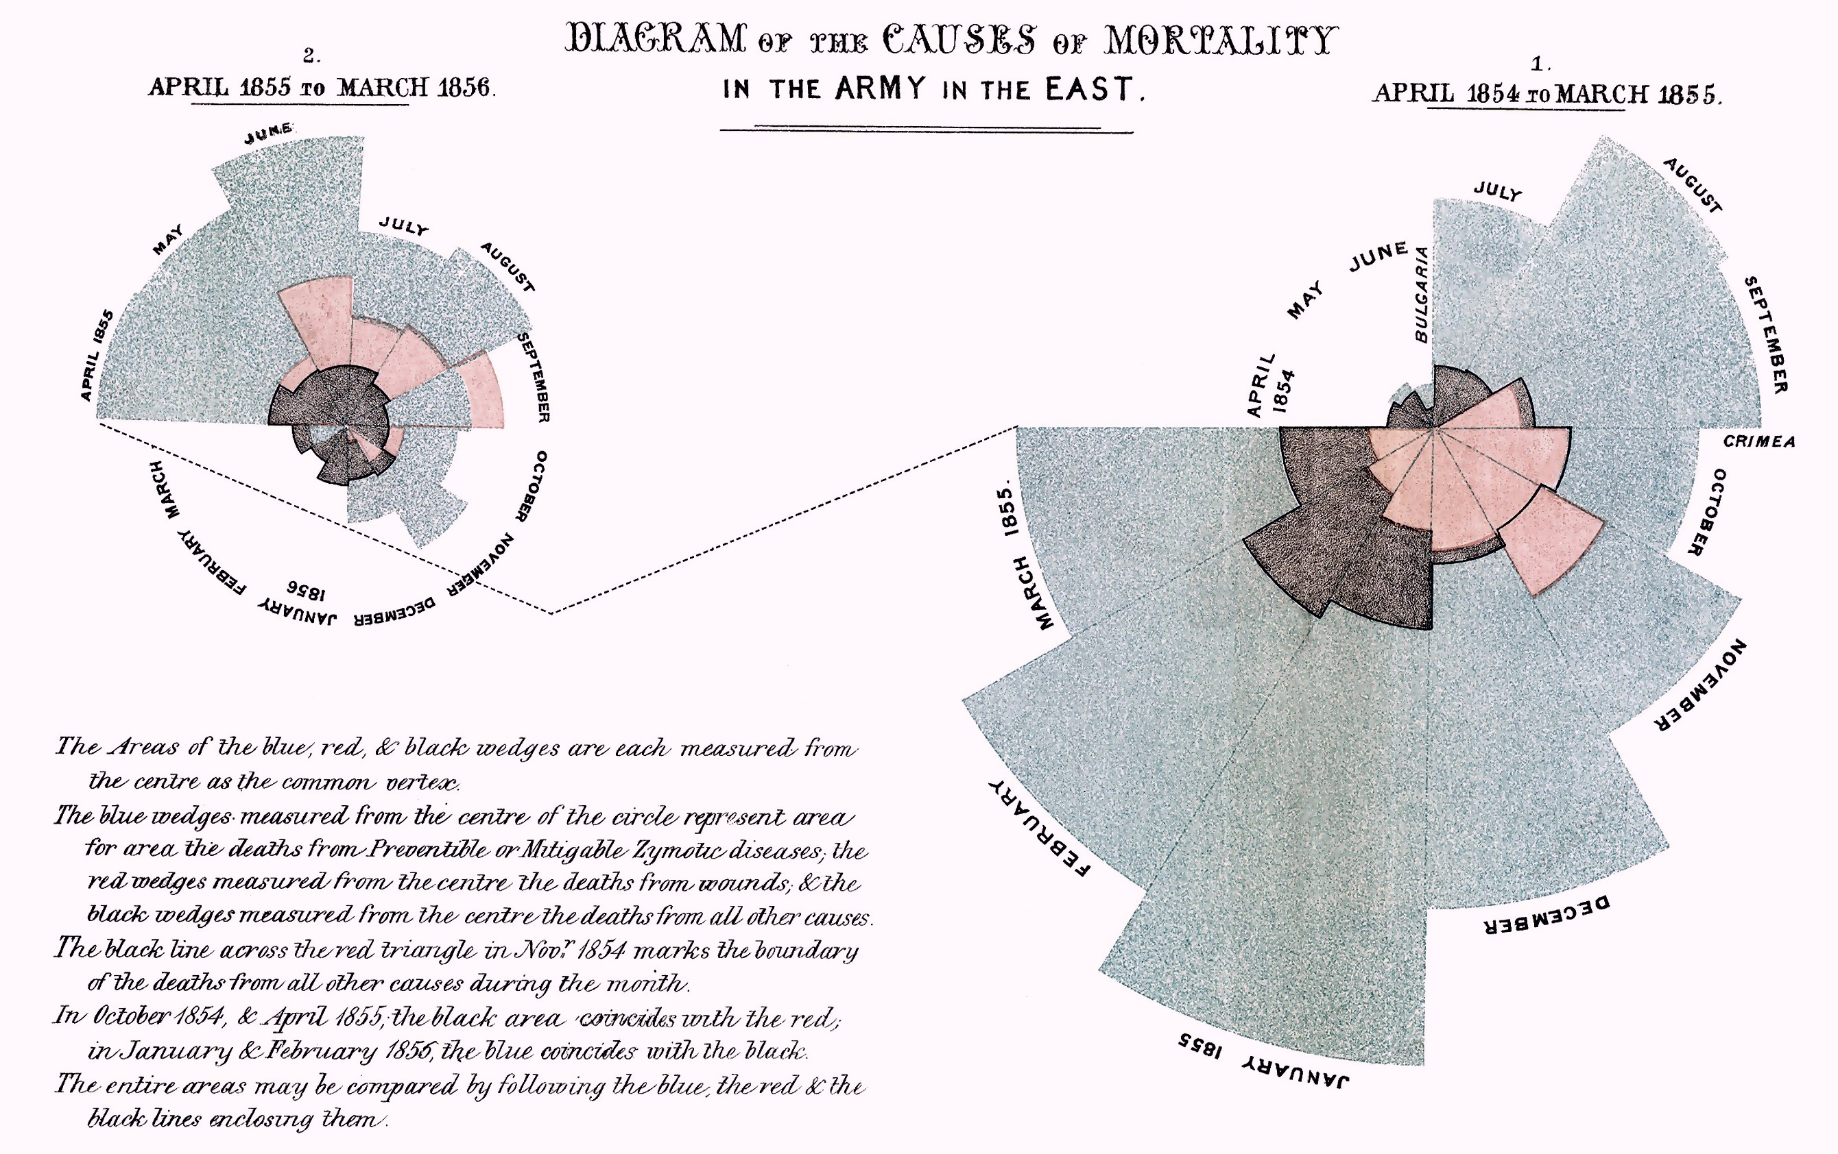
Notes:
Sometimes it can be powerful to show time in a radial mapping, like Florence Nightingale did in this famous graphic depicting deaths during the Crimean war. Called a rose chart, or coxcomb chart, where instead of a pie, the circle is broken into equal sized wedges according to angle, then it’s kind of like a histogram. You can also use this with clocks.
Sure mappings can be used to show seasonality, or cyclical patterns.
Could show this; http://understandinguncertainty.org/coxcombs

Slide 26
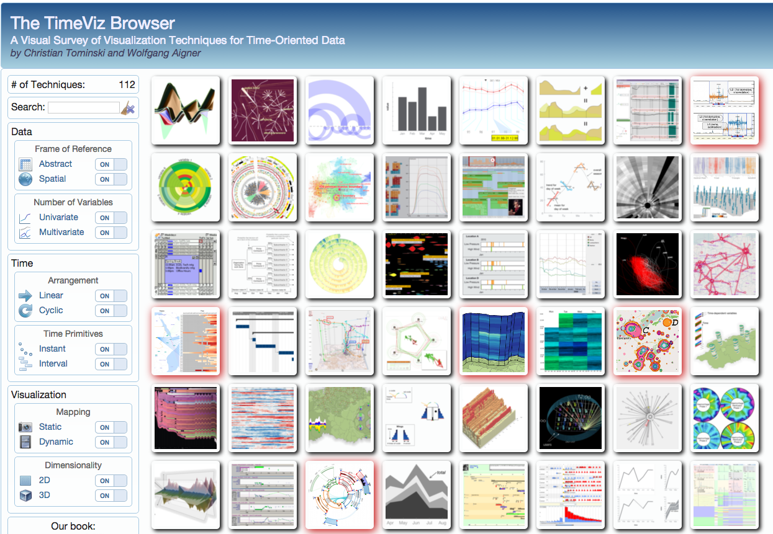
Inspiration
http://survey.timeviz.net/
Notes:
Some more inspiration

Slide 27
Tools
TimelineJS
http://timeline.knightlab.com/
TimelineSetter
http://propublica.github.io/timeline-setter/
WNYC Vertical Timeline
https://github.com/jkeefe/Timeline
All can be run off Google Spreadsheets!

Slide 28


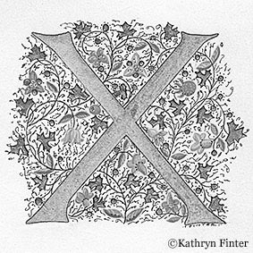
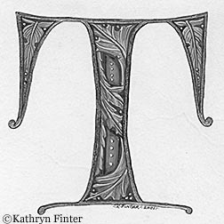

Slide 29
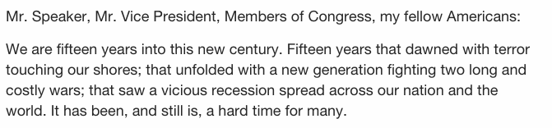
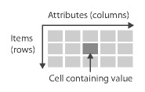
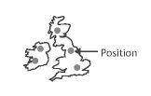
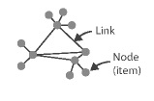
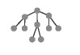

What’s Different about Text?
Text
A sequence of written or spoken words
Frequencies / rates, context, semantics
Tables
Geometric (2D or 3D)
Networks (graphs)
Trees (hierarchies)
Temporal
Image Credit: T. Munzner. Visualization Analysis & Design
Notes:
text is a somewhat unique data type. The position of words in a text defines what they mean, how they relate to other words.
So by counting we can create data tables from text, or we can transform to temporal by counting the number of times a word was used per time slice. Or we can make connections to geographic locations by counting them in text, or count collocations and map that to the strength of an association.
But texts also demand that we show context of words, due to its nature and the fact that meaning is contextually constructed. There’s a tension between the aggregate count which divorces from context and the actual placement of a word in its real context. The final level of text data are the semantics of terms – meanings can change – does this term represent a city, a corporation, or a particular part of speech? Perhaps this term is the direct object, or a verb is in the passive voice: these could all potentially be interesting dimensions to make visible.
You can create other kinds of derived values from texts as well, they’re very versatile. So people will create clusters of words that represent topics and a topic might include dozens of words that have different weights for that topic. Or you might compute text similarity metrics by creating document feature vectors that can be compared in some high dimensional space.
Also mention that we are often interested in entire text corpora or sets of text documents.

Slide 30
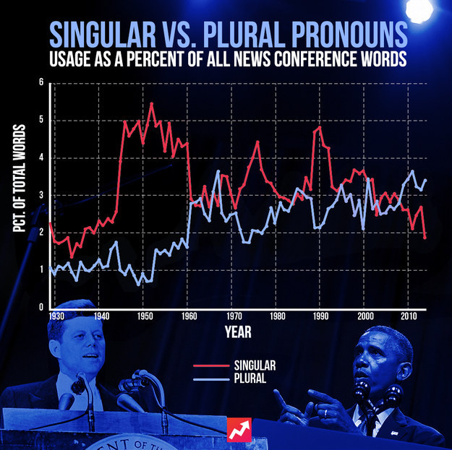
http://www.buzzfeed.com/johntemplon/obamas-pronouns-dont-make-him-narcissist#.kwxO33v7WG
Notes:
http://www.buzzfeed.com/johntemplon/obamas-pronouns-dont-make-him-narcissist#.kwxO33v7WG By Jon Templon at Buzzfeed
Counts over time, but not of words straighforwardly, but of semantic categories of interest.
This charts the use of pronouns over time for all presidential news conferences and shows a shift in speech writing over time from singular to plural forms.
This is more on the explanatory side of graphics. Showing and communicating a clear story with less (no in this case) interactivity.

Slide 31
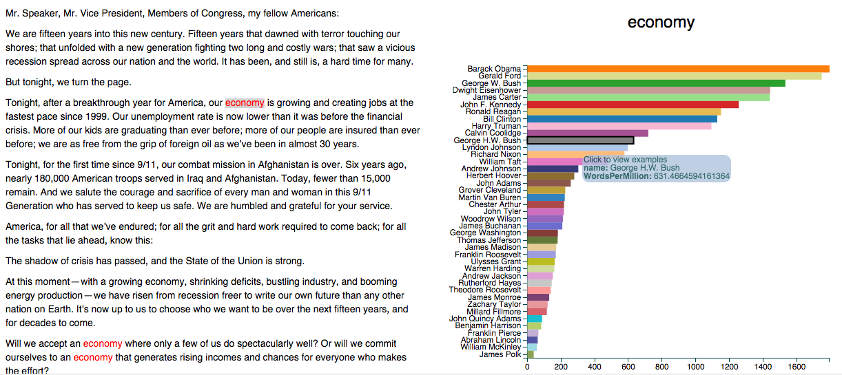
Counts + Comparison
http://benschmidt.org/poli/2015-SOTU
Notes:
http://benschmidt.org/poli/2015-SOTU?utm_campaign=Data_Elixir_20&utm_medium=email&utm_source=Data%2BElixir
Allows you to click a word in the SOTU and compare the rate of use of that word to all other president’s SOTU addresses.

Slide 32
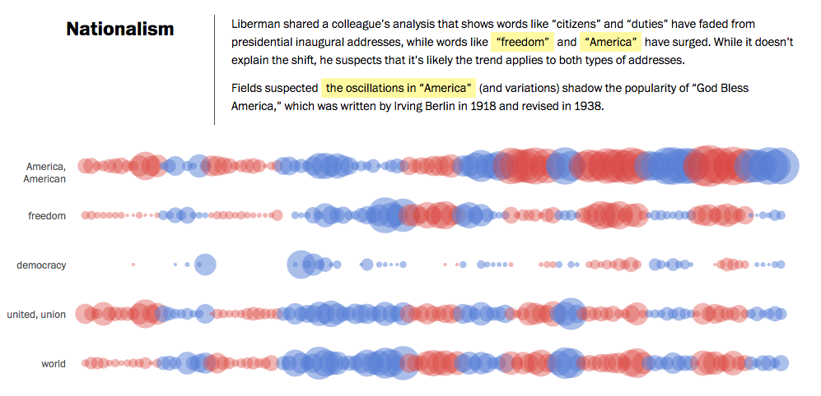
Counts Over Time + Semantics
http://www.washingtonpost.com/wp-srv/special/politics/2014-state-of-the-union/language-of-sotu/
Notes:
http://www.washingtonpost.com/wp-srv/special/politics/2014-state-of-the-union/language-of-sotu/
Counts over time, with semantic dimension (party). Plus storytelling and directing your attention
In the middle of exploratory and explanatory you have an example this this from the Washington Post (Kennedy Elliot and collaborators). It not only shows word use over time, but also color codes according the political affilitation, and draws out specific observations in this case about keywords relating to nationalism, but also foreign policy, economy, and other issues. So it directs your attention toward interesting observations, but also allows for some self directed exploration

Slide 33
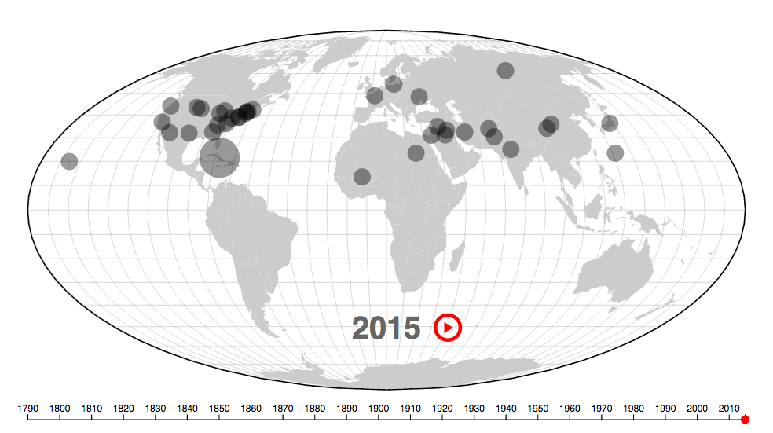
Counts + Maps
http://www.theatlantic.com/features/archive/2015/01/mapping-the-state-of-the-union/384576/
Notes:
http://www.theatlantic.com/features/archive/2015/01/mapping-the-state-of-the-union/384576/
Or this Atlantic piece which extracts the location names mentioned in SOTU over time and plots them in an animated map over time.

Slide 34
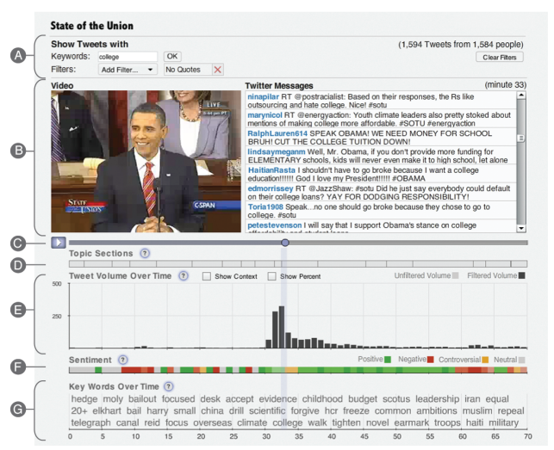
Diakopoulos et al. Diamonds in the rough: Social media visual analytics for journalistic inquiry. VAST 2010.
Notes:
Example synthesizing 2 types of data – volume / count, and semantics (sentiment and keywords). Trying to combine different views on to the text data, and also provide some indication of textual structure (topic sections) and even align with the video

Slide 35
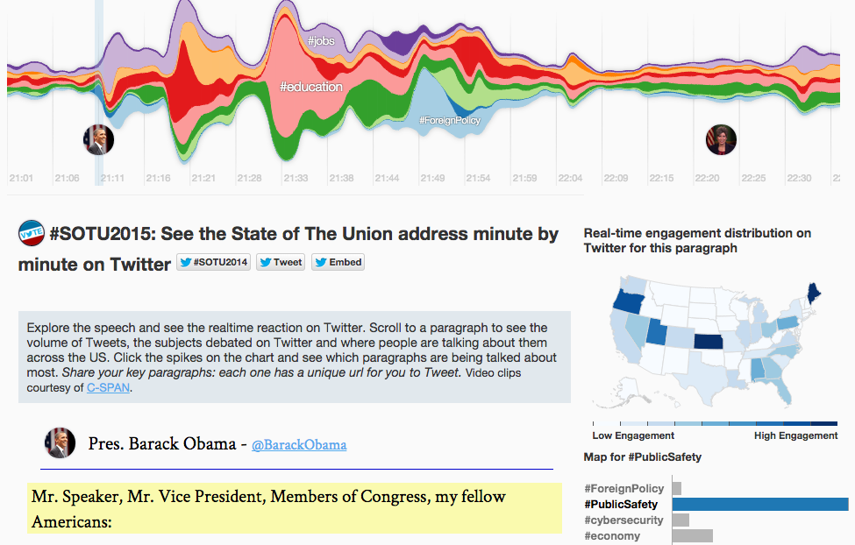
http://twitter.github.io/interactive/sotu2015/#p1
Notes:
Based on the original work called Themeriver- idea is to show how different topics or in this case hashtags evolve over time. Notice how they combine several data scheme in one dashboard (time, geography, and count)

Slide 36
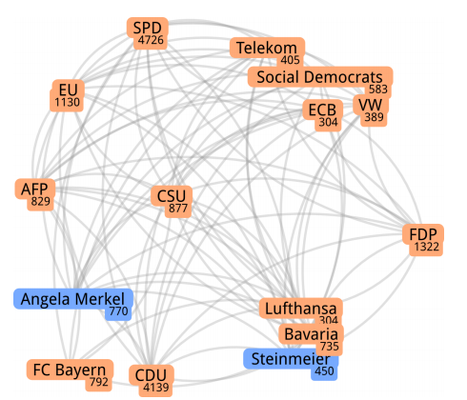
Networks
Networks of Names: Visual Exploration and Semi-Automatic: Tagging of Social Networks from Newspaper Articles. EuroVis 2014.
Notes:
From german news paper articles. Vertices are people or organizations that are extracted and counted automatically, Edges are binary relationships reflecting their appearance in the same sentence.

Slide 37
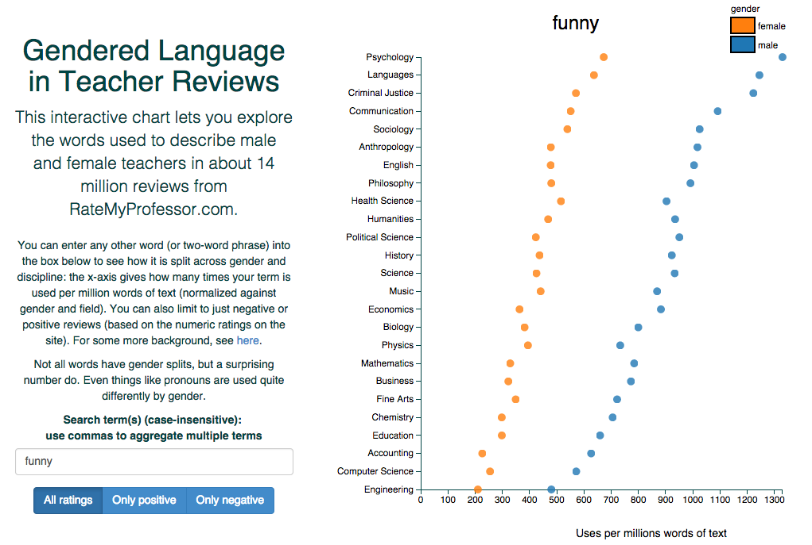
http://benschmidt.org/profGender/
Notes:
And of course there are applications outside of politics here. Including this piece by benschmidt comparing the use of words in different disciplines from reviews on ratemy professor.com
There are many many stories waiting to be told, and visualized from text corpora. Twitter, Yelp, Movie reviews, Online comments, News articles, Politicians quotes, government records and documents.

Slide 38
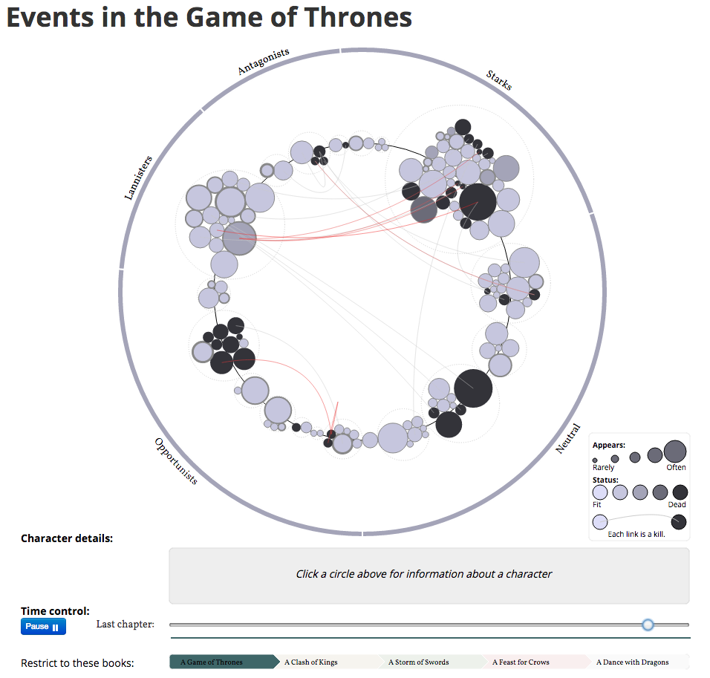
http://www.jeromecukier.net/projects/agot/events.html
Notes:
There are all kinds of applications outside of journalism too, to do interesting projects on culture. E.g. this interactive vis that animates over time and shows the affiliations of various characters in GoT as well as whether they’re alive and who killed them if they’re not

Slide 39
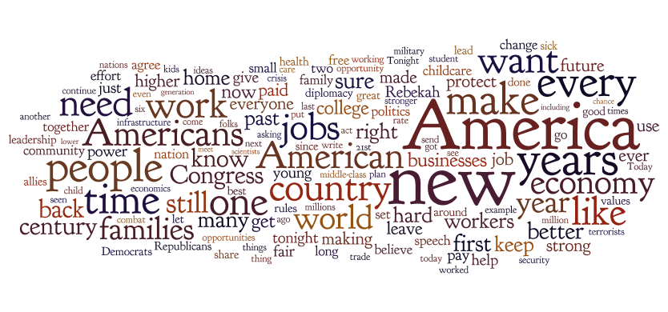
Wordles
http://www.wordle.net/create
Notes:
A fun way to get across the gist of a bunch of text, it’s counting up the frequency and mapping that to font size, font weight, color, or intensity, then running a space packing algorithm to try to get everything to fit together nicely.
As a result, the position of the words isn’t meaningful (neither are the colors in this case). And you can see issues with something we’ll visit later called “stemming” since you have the same word “americans” “american” and “america” appearing 3 times in slight variations. At the same time, it does give a very coarse and easy entry point.

Slide 40
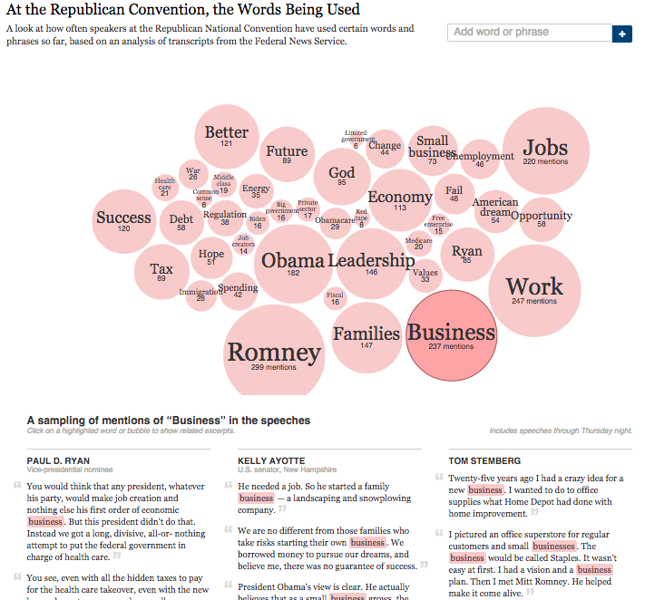
Notes:
http://www.nytimes.com/interactive/2012/08/28/us/politics/convention-word-counts.html#Business
So you see things like this emerging. Which map word counts at events like the republican convention, as well as showing you the real word context for those words, in this case “business” is selected.
Point out that the visulaization below is called KWIC – keyword in context. It’s meant to help you scan and find the interesting word within the text block.

Slide 41
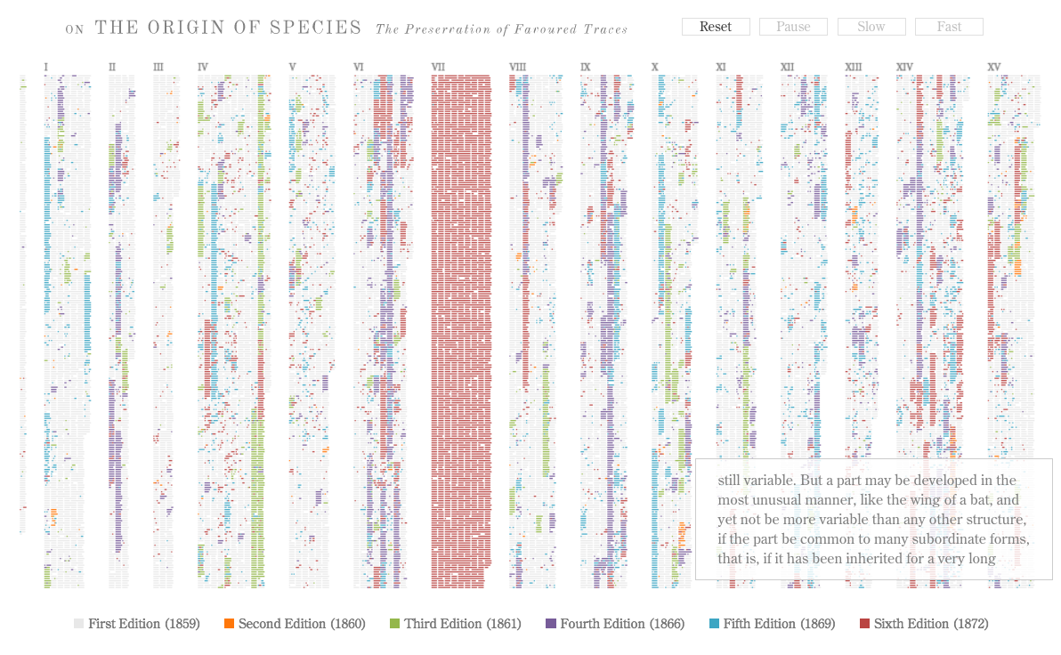
http://benfry.com/traces/
Notes:
This of course deserves a much higher resolution display than we have, but perhaps you can get the gist of what this is showing. A project from Ben Fry (creator of processing) It is actually animated online and you should take a look there. But what it shows is the evolution of new chunks of text being added to subsequent editions of “On the origin of species” by charles darwin.
It gives a great overview, but also shows you where the new material is added over time and distributed through the volumes of the work. An evolution.

Slide 42
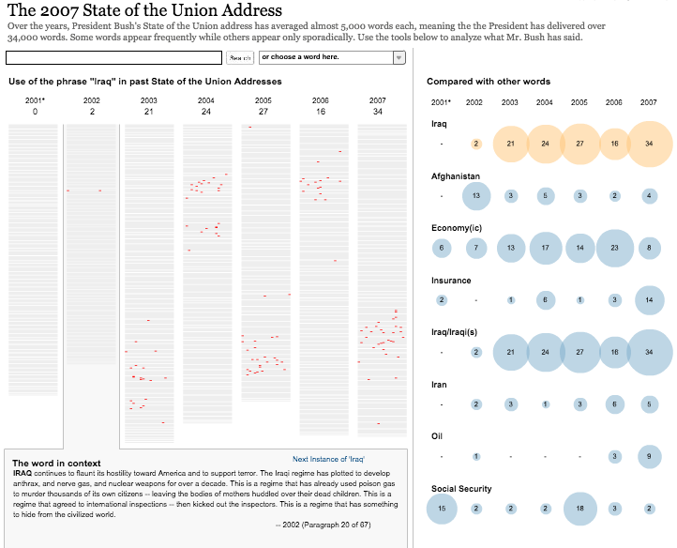
http://www.nytimes.com/ref/washington/20070123_STATEOFUNION.html?initialWord=iraq
Notes:
And you also see this technique being used in news visualizations, this one from the NYT, which shows the position of the use of various words within the SOTU’s of George Bush. Allowing you to search and see structurally where such terms were used. This is layered in with the display at right, which shows a bubble chart of the volume of use over time, to draw your attention to key terms being used.
This also allows for some comparison, at least to a point.
But what do you do when your volume of text goes up an order of magnitude?

Slide 43
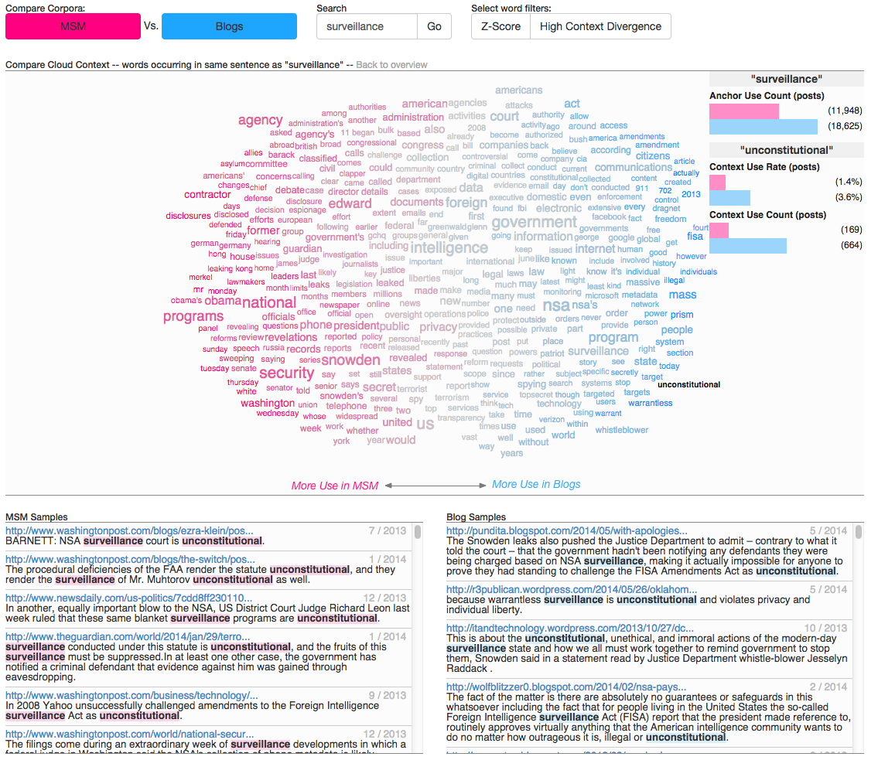
N. Diakopoulos, et al. Compare Clouds: Visualizing Text Corpora to Compare Media Frames. Proc. IUI Workshop on Visual Text Analytics. 2015.
http://nad.webfactional.com/lingoscope/v2/
Notes:
An undersupported task in text analysis is the ability to compare large volumes of text, and to try to represent and compare contexts without showing every sentence explicitly.
In this technique, called a compare cloud, we developed it to try to explicitely encode differences between two corpora, in this case a set of thousands of blogs posts and thousands of news articles talking about the issue of surveillance after the snowden documents were released. You can see striking differences in how words or used together with the word “surveillance”. For instance “unconsituttional” is used much more frequently and at a higher rate by blogs, than MSM. In contrast, MSM used terms like “security”. This is a tool for seeing media frames in discourse.

Slide 44
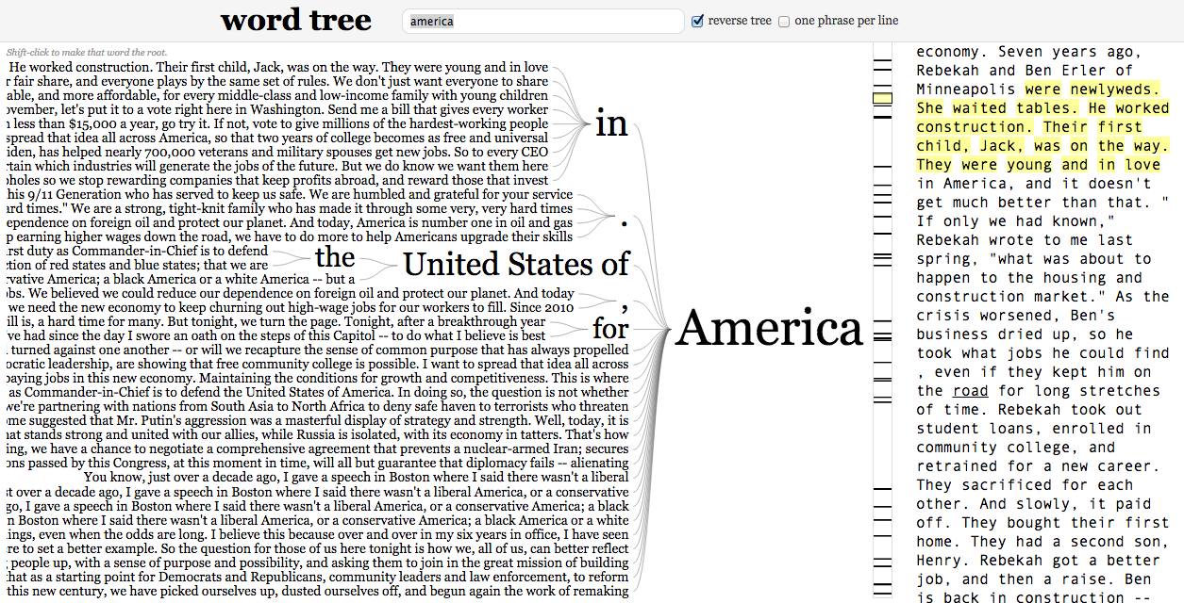
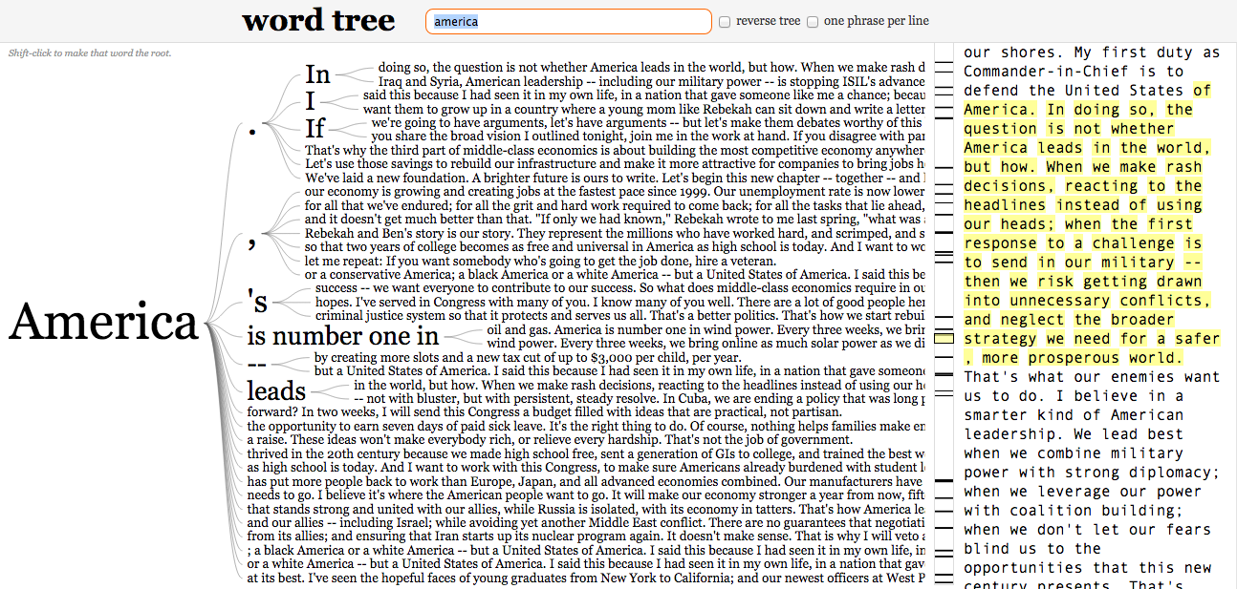
Word Tree
http://www.jasondavies.com/wordtree
Notes:
So you also have things like word trees, which try to walk this line of showing you frequency and structure. In this case we see this years SOTU with “america” at the root. And we can see a few of the similar phrases that were built around that root term.

Slide 45
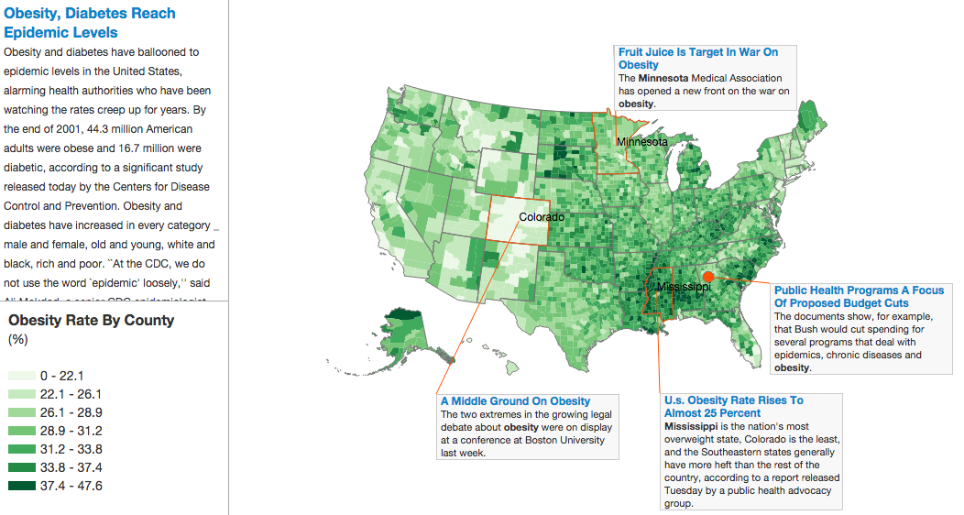
News Views
T. Gao, J. Hullman, E. Adar, B. Hecht, N. Diakopoulos. NewsViews: An Automated Pipeline for Creating Custom Geovisualizations for News. Proc. Conference on Human Factors in Computing Systems (CHI). May, 2014.
Notes:
And at the other end of the spectrum of text visualization of semantics is really inferring a high degree of semantics from the text, about the intent of a visualization (not using text as the data source, but using text to indicate other data sources that should be visualized). These systems are all very much research prototypes at this stage.

Slide 46
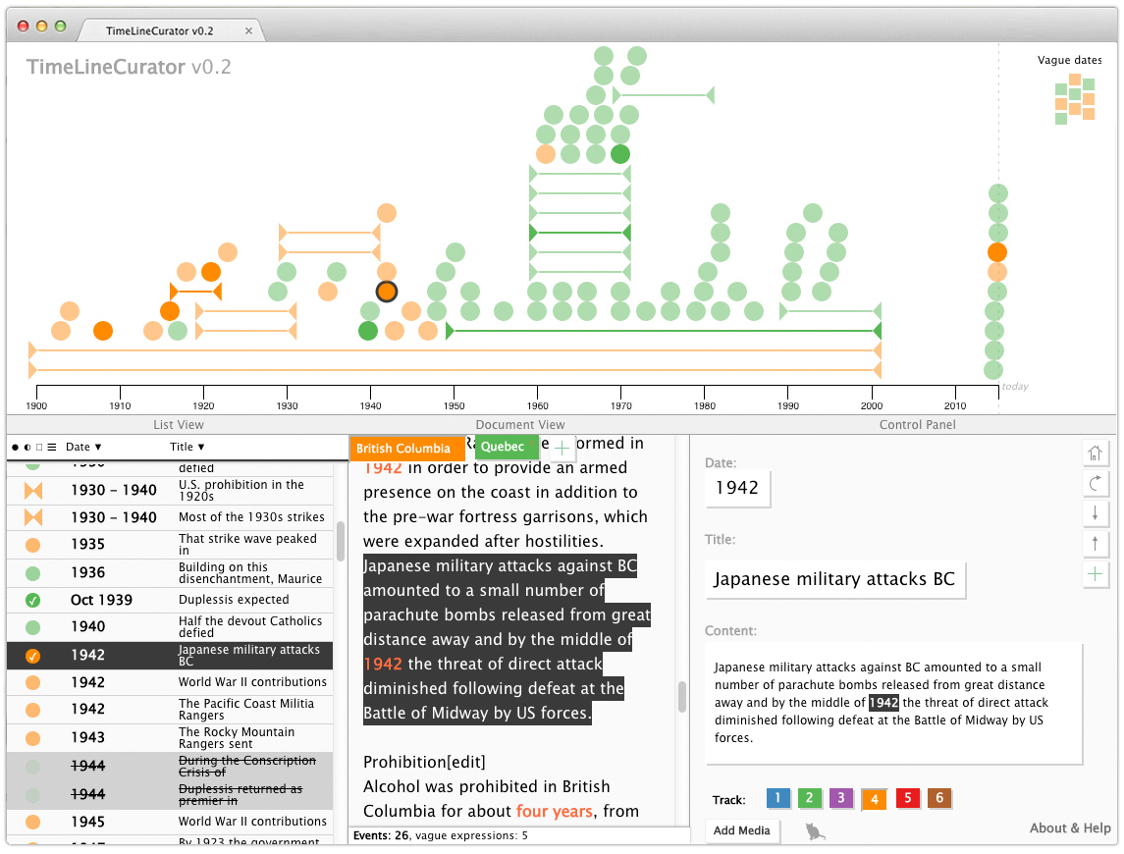
Timeline Curator
http://www.cs.ubc.ca/group/infovis/software/TimeLineCurator/
Notes:
Also on that end of the semantic spectrum is Timeline Curator, a protytpe being developed at the UBC vizualization lab by Tamara Muntzner. It analyzes texts to extract temporal semantics and then can automatically craft a timeline.js visualization.

Slide 47
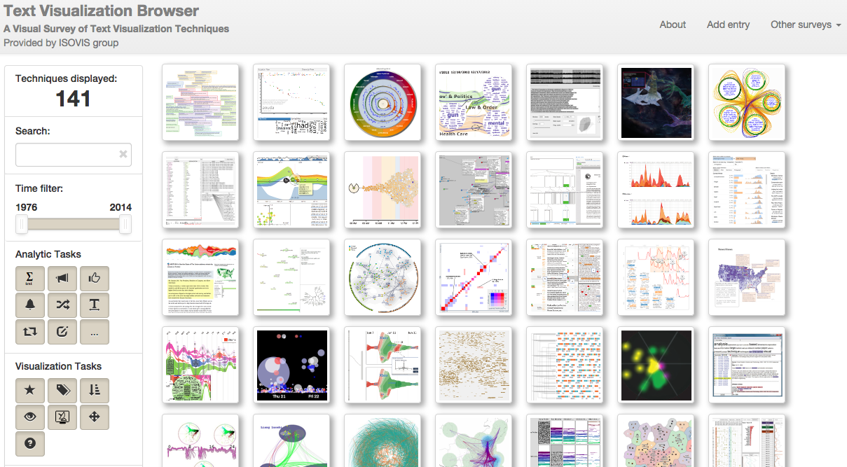
http://textvis.lnu.se/
Notes:
And if you’re lacking for inspiration check out the Text visualization browser which has 141 different text vis techniques which cover different data sources, analytic tasks, domains, visual scheme

Slide 48
Let’s Make a Wordle
from Scratch!

Slide 49
Processing Text
How do we go from a blob of text to something we can actually work with?
What can we count?
What tools can we use?
Notes:
So to get to a point where we can do some of these visualizations, we need to process the text and count some things, or extract additional information from the texts, like associations or higher level semantic constructs. So let’s talk about that for a bit and then use that to create a wordle

Slide 50
Text Processing Pipeline
Initial Text
We are fifteen years into this new century.
Lowercase
we are fifteen years into this new century.
Tokenize
we | are | fifteen | years | into | this | new | century | .
Stem
we | are | fifteen | year | into | thi | new | centuri | .
Stop Word Removal
we | are | fifteen | year | into | new | centuri
Notes:
Stemming is about getting the root version of a word. E.g. plurals are reduced to singulars
Stop words are usually short and relatively meaningless words that are very frequent. BUT sometimes they are meaningful so you think before you remove them

Slide 51
Pipeline Pointers
Lowercasing
Usually it’s ok, but sometimes capitals matter, e.g. in peoples titles
Tokenization
If tokenizing sentences, you need to be careful for things like
“Mr. Speaker, Mr. Vice President”
Stemming
Is language specific
May need reverse-stemming to be presentable back to the user
Notes:
You can also tokenize on things like sentences. That’s tricky b/c you have to worry about periods within the sentence throwing things off.

Slide 52
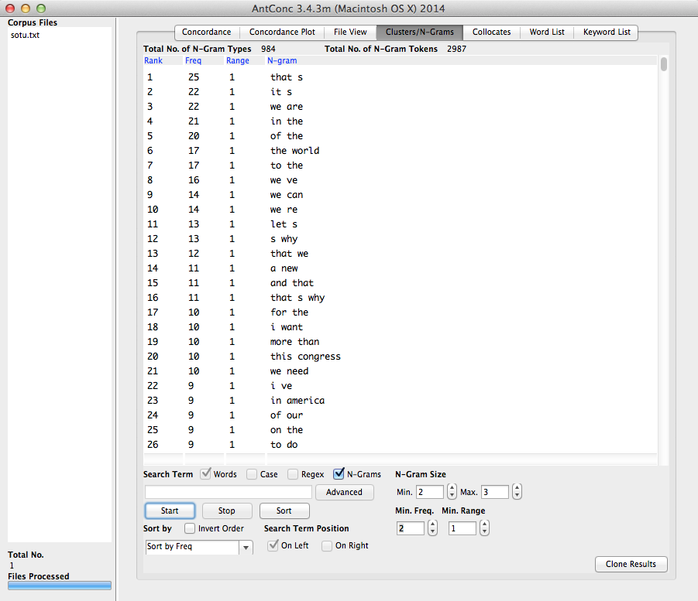
Counting Stuff
Unigrams
Bigrams
N-Grams
Collocations
Regular
Expressions
“keyness”
Classes
AntConc
Notes:
Simplest thing you can count are individual words, but you can also count things like bigrams, trigrams, or n-grams. You can count the number of times one unigram occurs to the left or right of another, etc etc.
You have tools like AntConc which can help with the exploration of texts.
Talk a bit about keyword extraction, how you can load in other corpora of text to highlight words that are used at a statistically higher rate than some reference corpus.
Collocation is the frequency of two words occurring together.
Regular expression might be extraction things like phone numbers, or addresses from text

Slide 53
Linguistic Resources
Linguistic Inquiry and Word Count
Dictionaries for: affective words (pos emotions, neg emotions); perceptual processes (see, hear, feel); biological processes (health, sex); work; leisure; death; religion; family & friends
General Inquirer
Dictionaries for: pleasure; pain, arousal; virtue; vice; economics; legal; military; political, etc etc etc
BUT, dictionaries aren’t adapted to domain, to slang or informal language etc.
Notes:
Oftentimes you want to count categories of words – basically to aggregate different words into meaningful groups.

Slide 54


Advanced Analysis
Part of Speech Tagging
Count interesting things like superlatives, comparatives, prepositions, pronouns
Use of word, e.g. “combat” N or V?
https://www.ling.upenn.edu/courses/Fall_2003/ling001/penn_treebank_pos.html
Notes:
You need to be aware that these algorithms are not always correct. They can make mistakes. So if you’re doing more sophisticated semantic analysis make sure you double check that derived data before you make any serious inferences.

Slide 55



Advanced Analysis
Named Entity Extraction
Identify people, places, organizations as such
Tough b/c of ambiguity in text, “Athens” GA or Greece?
New names always coming into existence so dictionary lookup doesn’t extend well
Notes:
This is a tough problem – definitely don’t recommend trying to roll your own.
There are other sorts of advanced analytics that you can do with text as well, like sentiment analysis
Use one of the many APIs that are available for this. If your volume is not too high you should be able to do it for free.

Slide 56

Alchemy API
Notes:
For instance, Alchemy API can extract all of the entities for you, and tag them with their type, or which their sentiment as used in the text, not to mention with links out to the semantic web so that you can get metadata on them.
Alchemy can do all sort of other things too like extract quotes from people and associate the quote to the person who said it.

Slide 57
Let’s Make a Wordcloud!
On Github download sotu_words.txt
On Safari go to Wordle.net
Text analysis with AntConc
http://www.laurenceanthony.net/software/antconc/
Notes:
Even though there are layout params you can tweak, limitation of Wordle is in colors and layout. Also analytically wordle isn’t very helpful, but it can be useful for “gisting”
Illustrates issue with word variations: america, american, americans

Slide 58
Advanced Text Processing
Let’s Look at Sage Math Cloud & Some Python:
https://cloud.sagemath.com/projects/676b6f88-7161-4b9c-a300-30a07b99db8f/
To get the Jupyter Notebook:
http://bit.ly/1AxQyqX

Slide 59
Network Visualization
Data
Twitter users discussing #immigration on April 11, 2015
On Github download: immigration-combined.xlsx
https://www.google.com/fusiontables
Tools
Google Fusion Tables
Gephi
NodeXL

Slide 60
Questions?

